Slide 1


Computational Biology Techniques II
NetworkX &
Pathways

Slide 2


Team members
يوسف خليفة احمد
مصطفى خلاف خليفة
احمد صلاح
احمد عبد العال
ديفيد حاتم جرجس
ارميا نادر

Slide 3
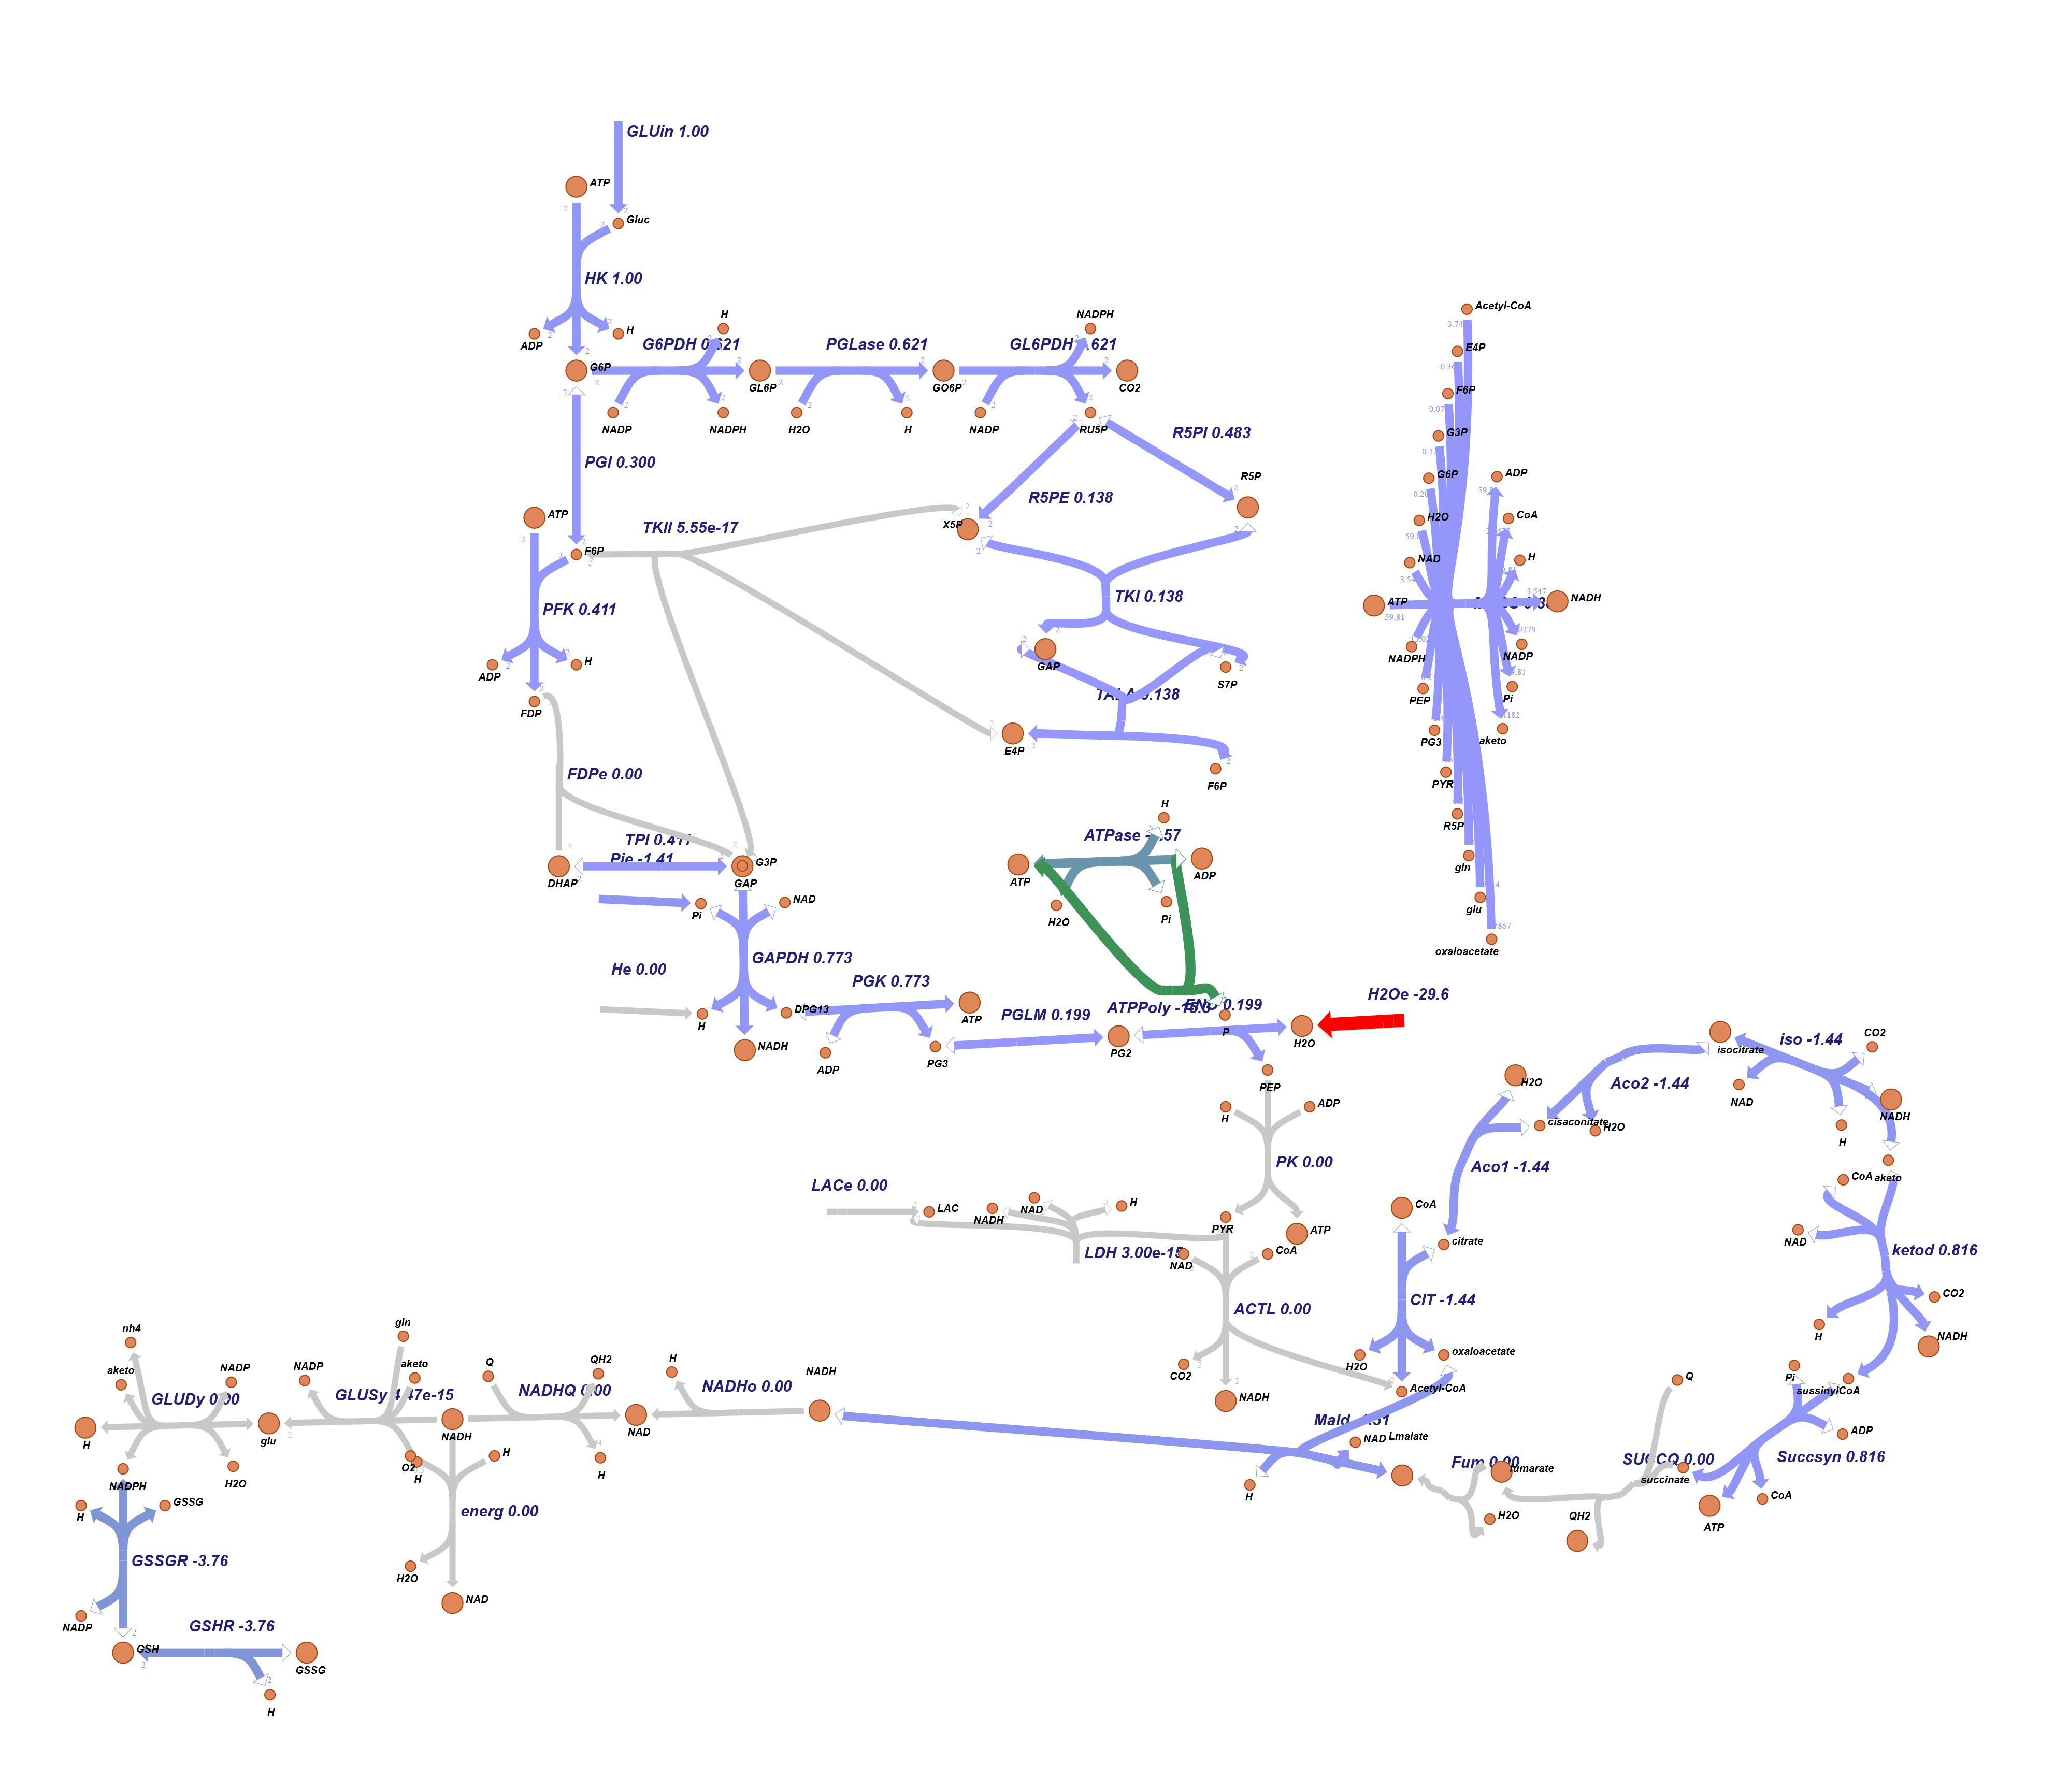
Pathway esher model map

Slide 4
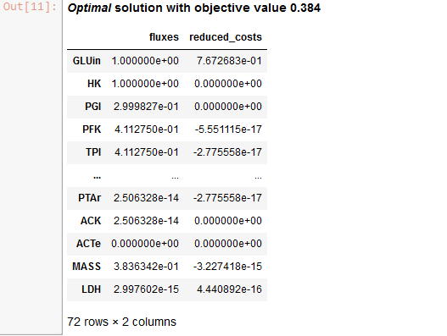
Model optimize

Slide 5
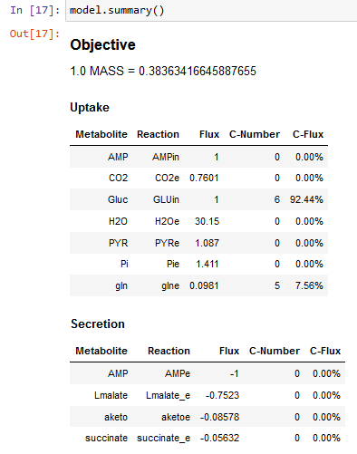
Model summary

Slide 6
NetworkX
Escherichia Coli

Slide 7
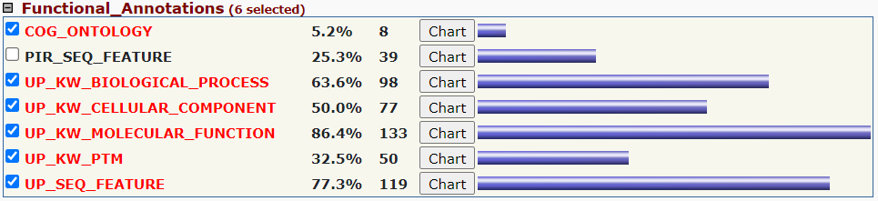
Davidtools results

Slide 8
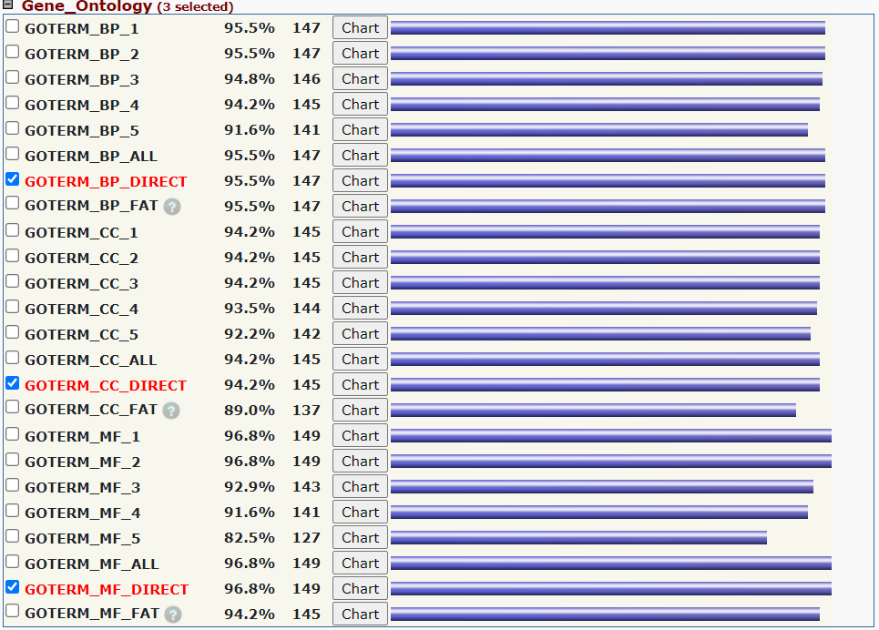

Slide 9
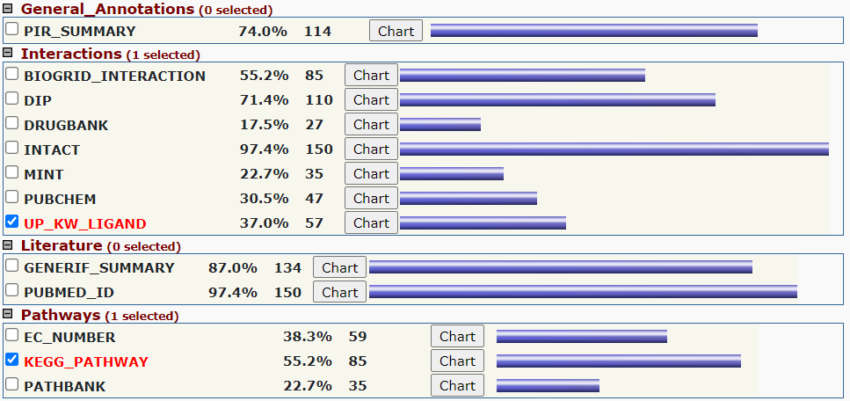

Slide 10
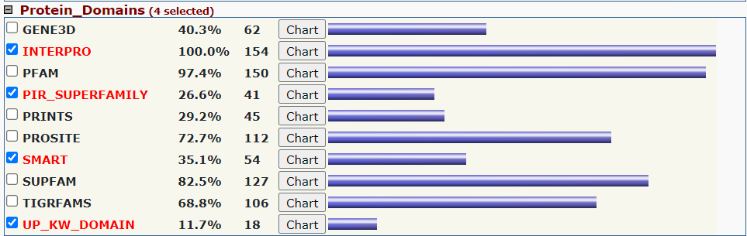

Slide 11
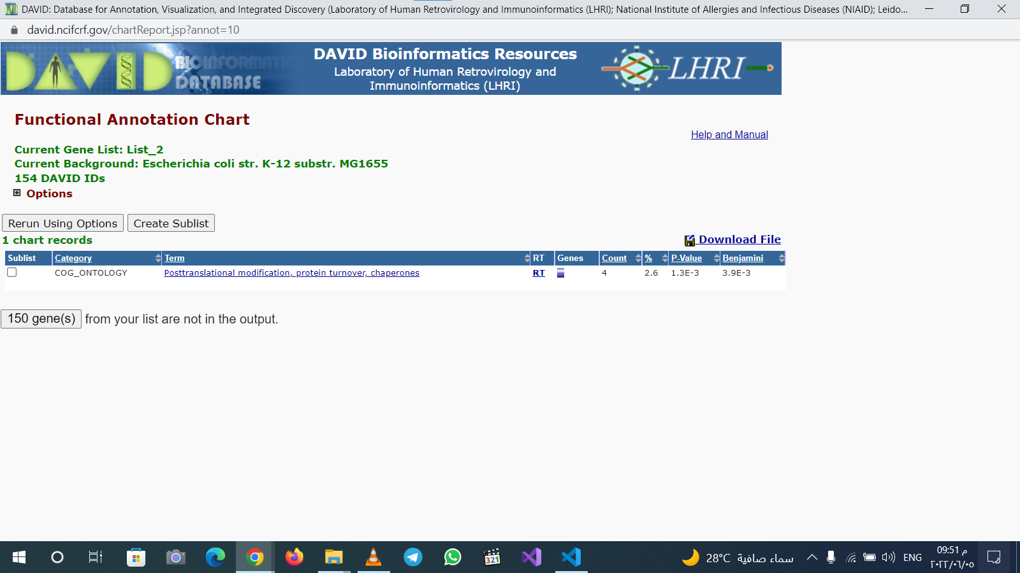

Slide 12
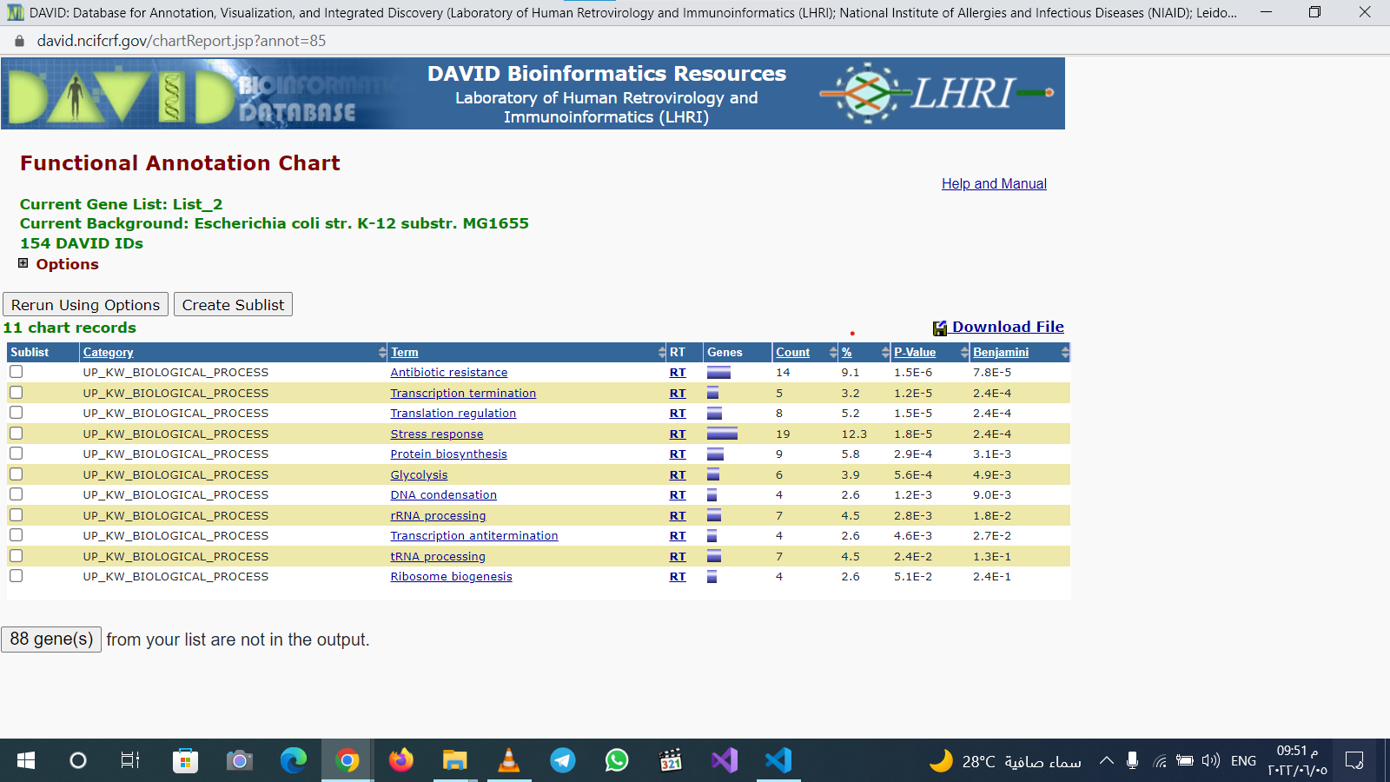

Slide 13
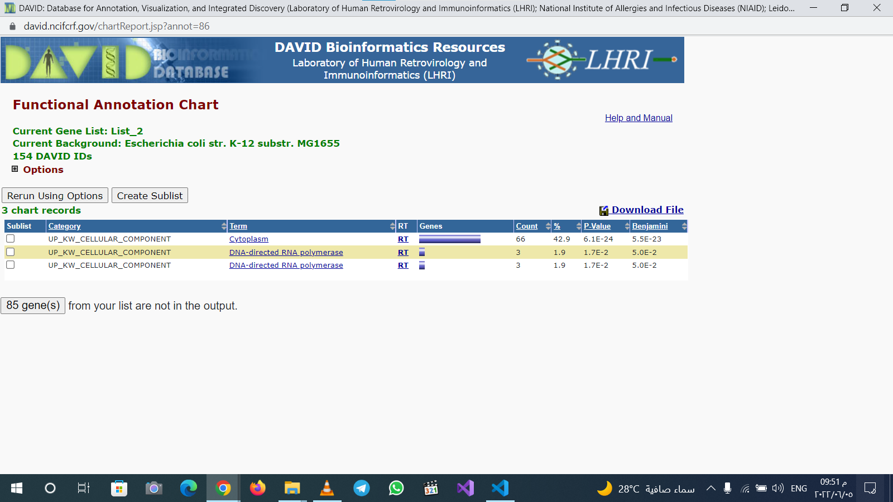

Slide 14
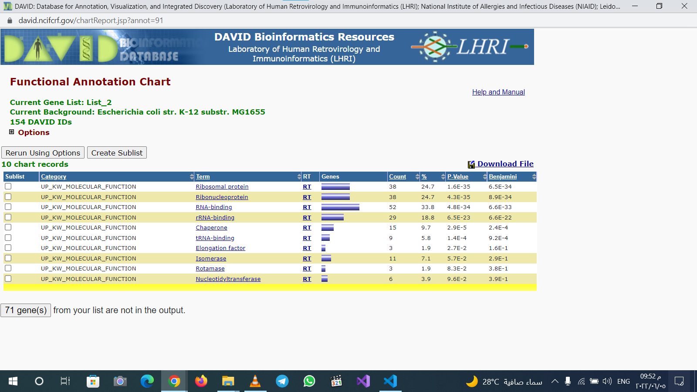

Slide 15
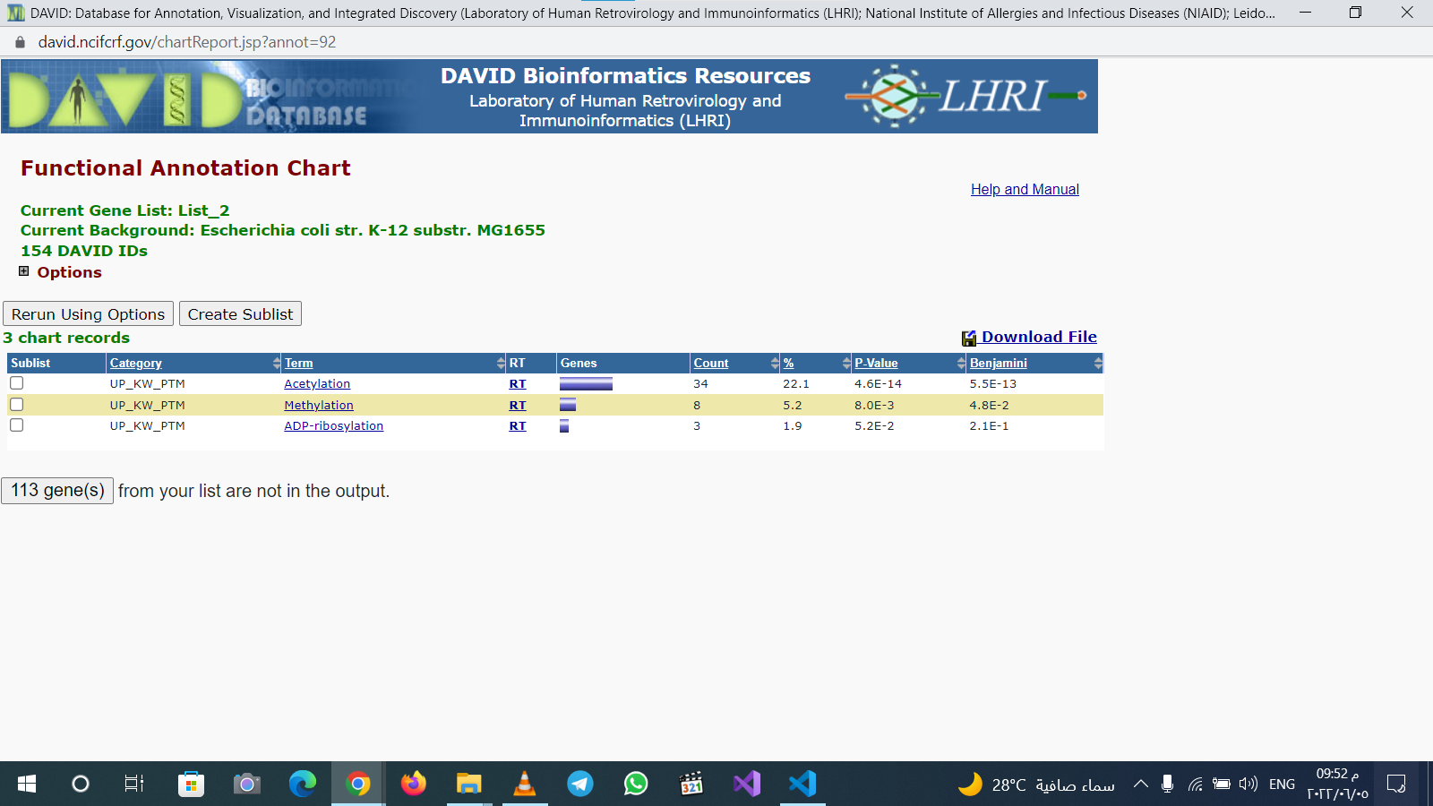

Slide 16
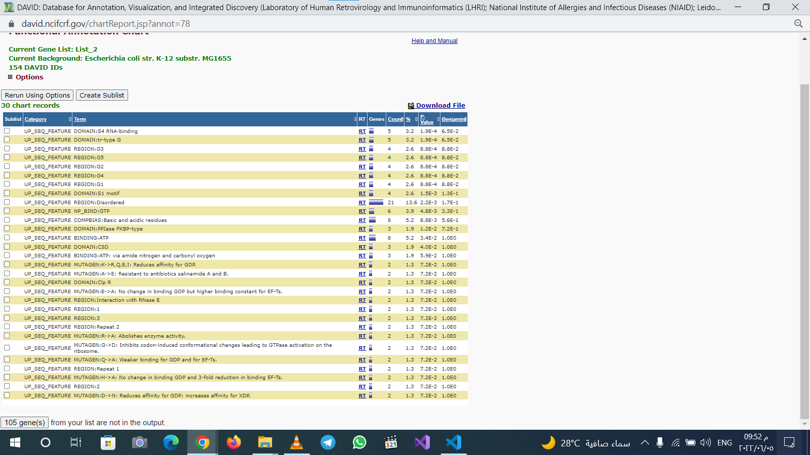

Slide 17
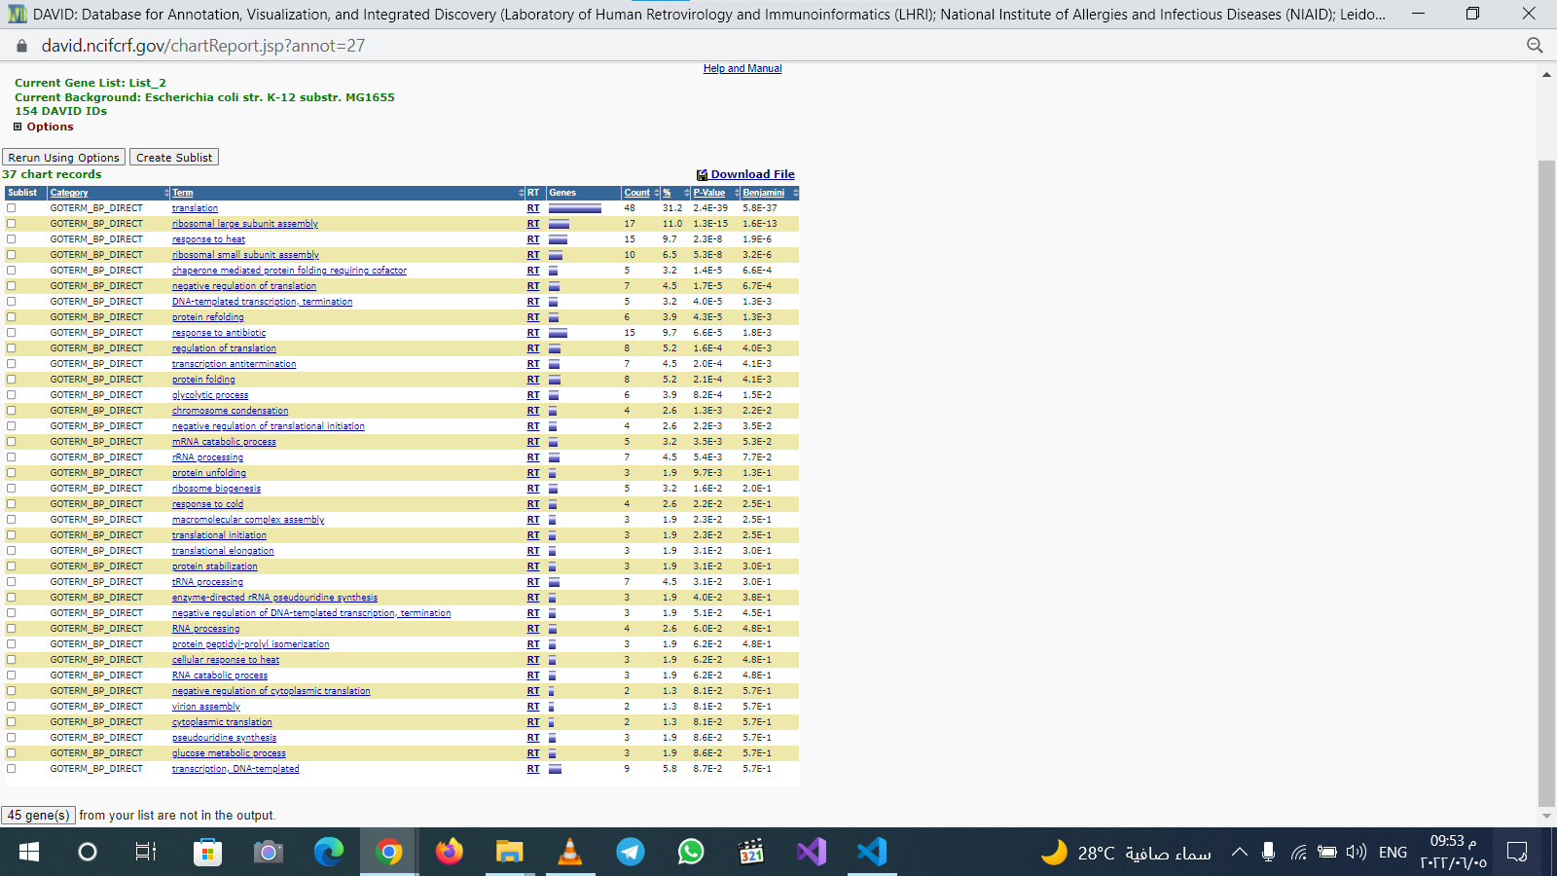

Slide 18
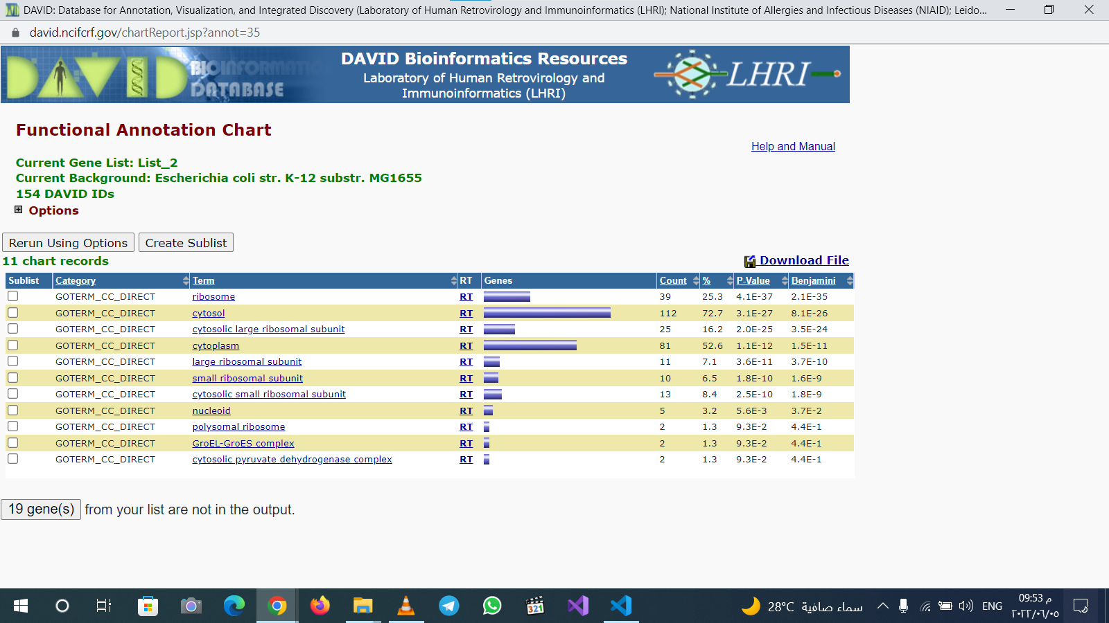

Slide 19
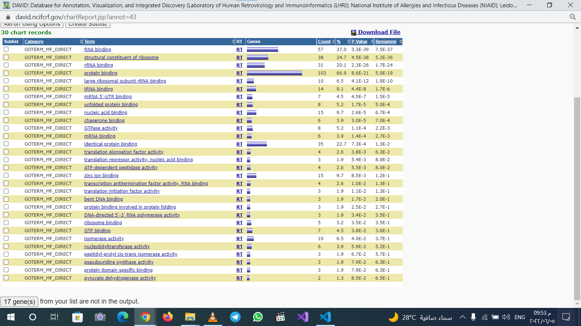

Slide 20


Slide 21
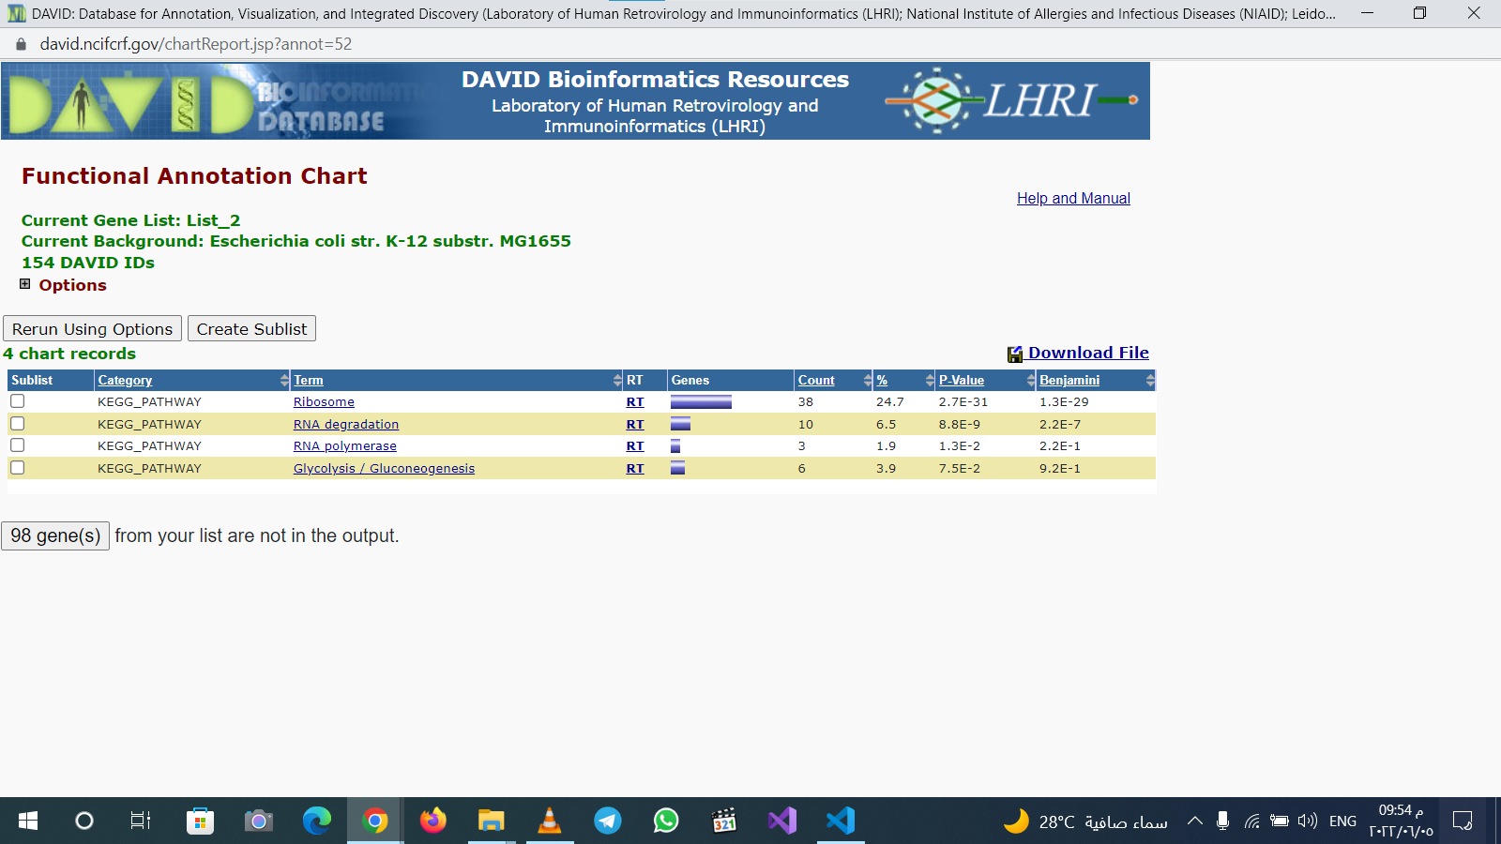
EscherichiaColi

Slide 22
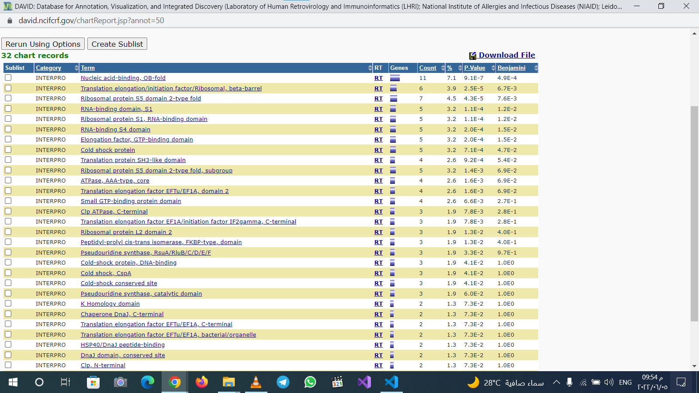

Slide 23
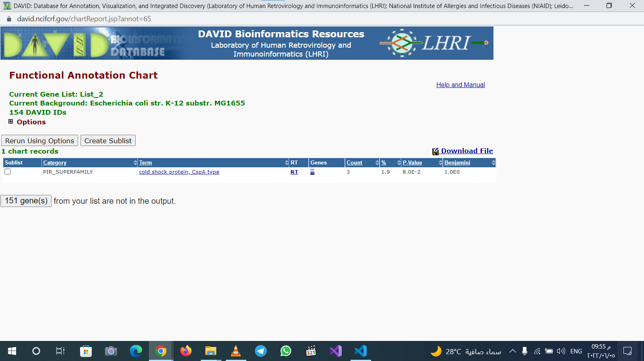

Slide 24
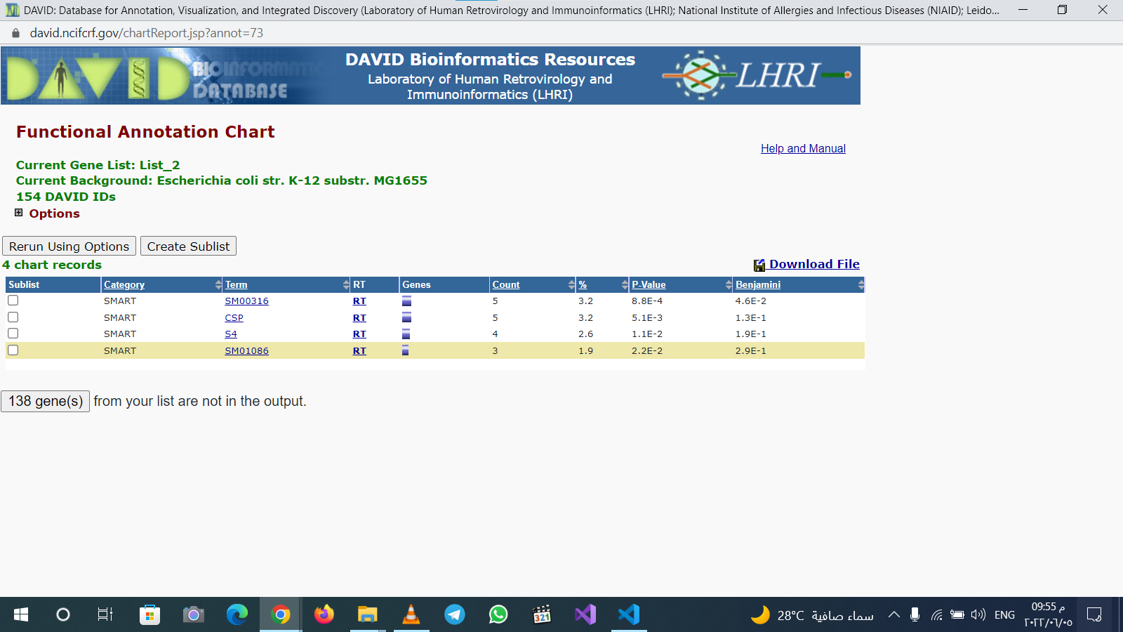

Slide 25


Slide 26


Slide 27
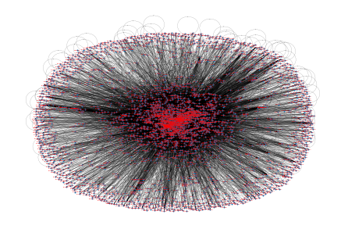
network

Slide 28
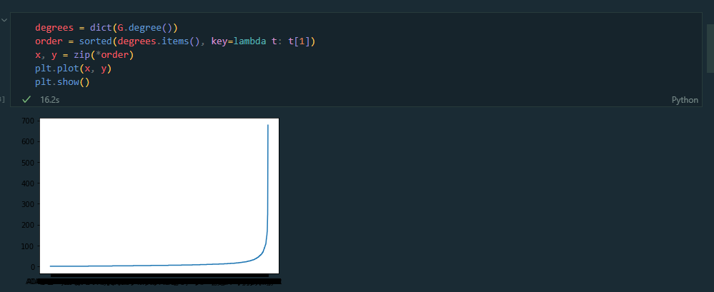
Degree plot

Slide 29
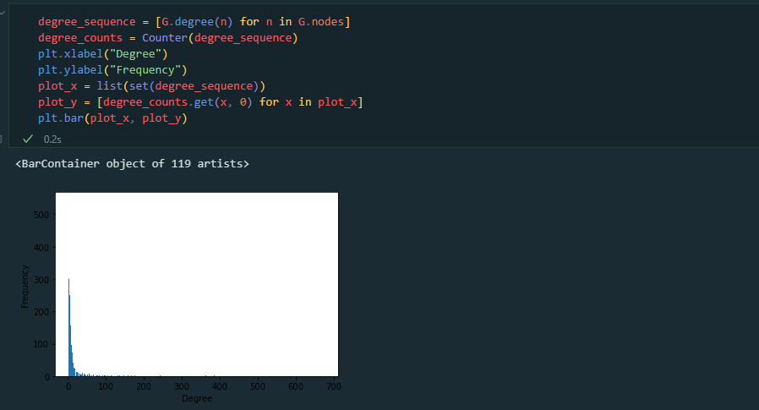
Degree sequence and counts plot

Slide 30
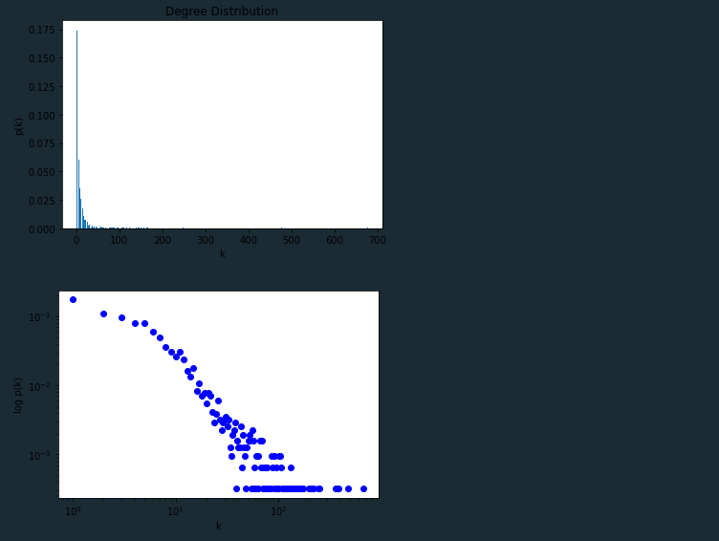
Degree Distripution

Slide 31
P(K) and K plot

Slide 32
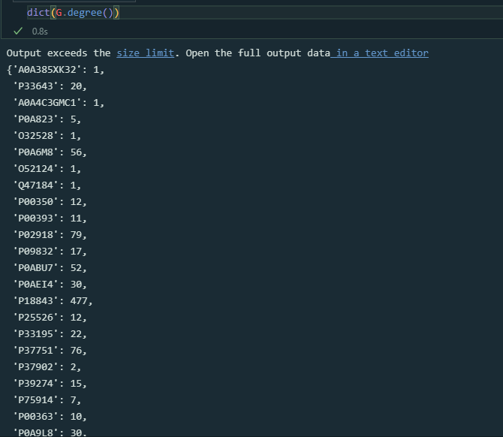
Node degree dict

Slide 33
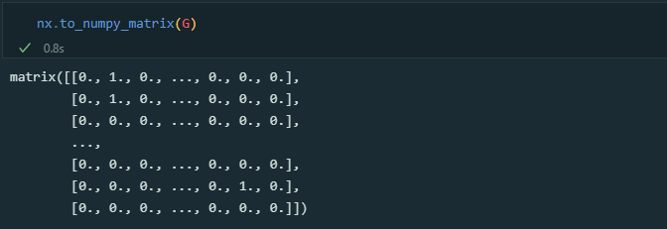
Network matrix

Slide 34
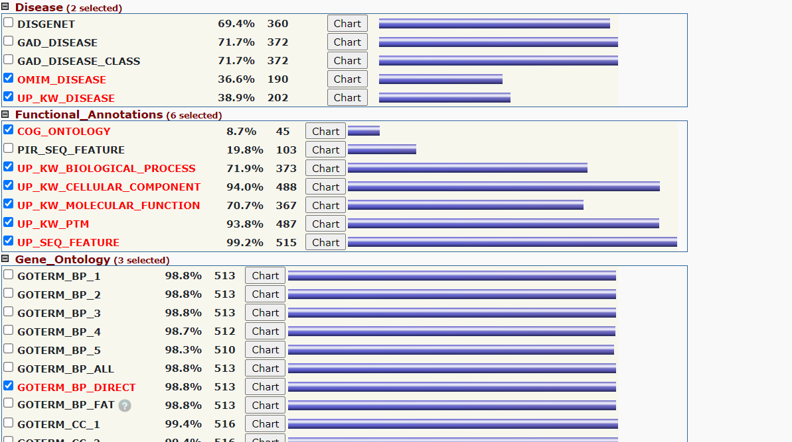
Homo Sapiens -David tools

Slide 35
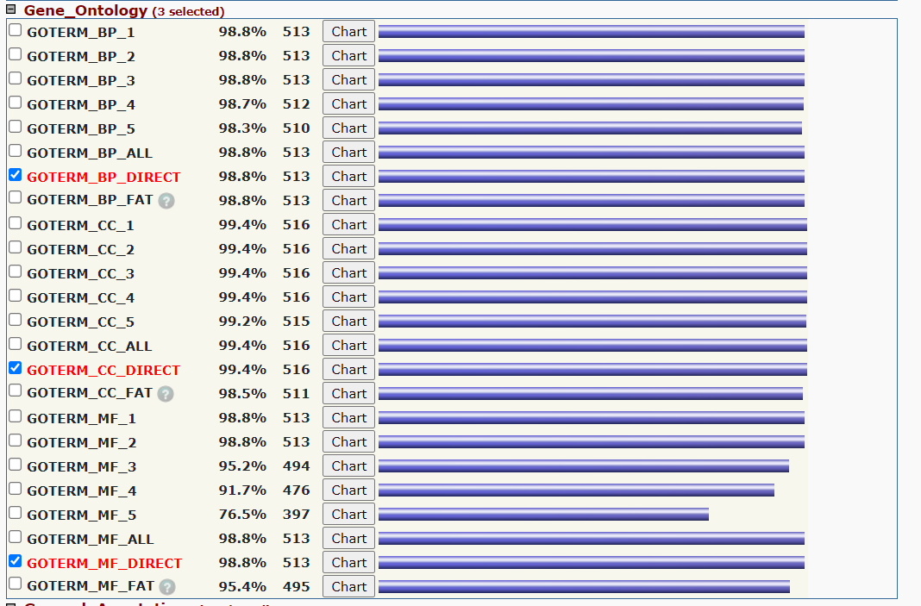

Slide 36
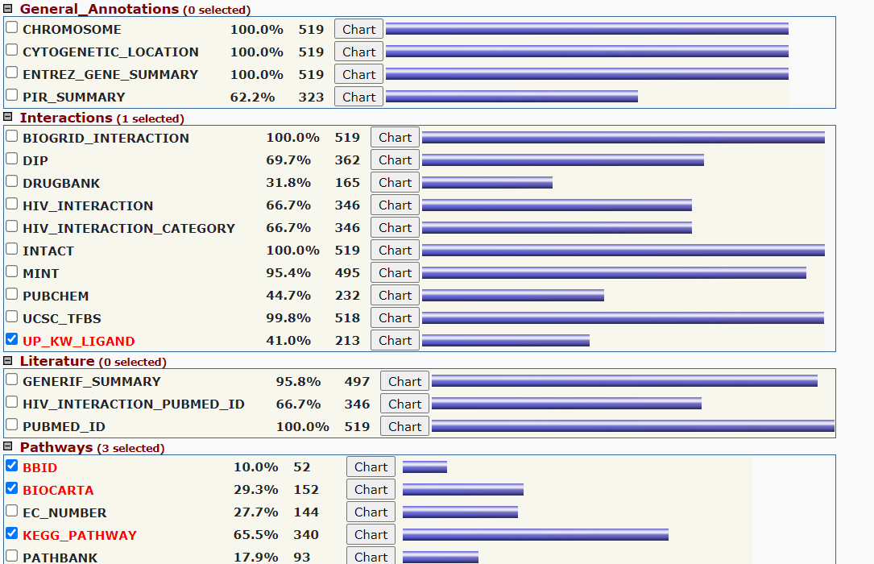

Slide 37
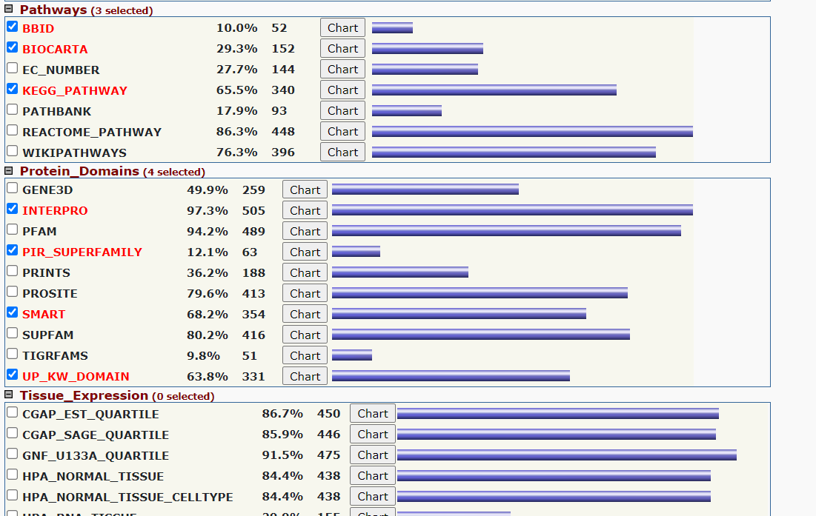

Slide 38
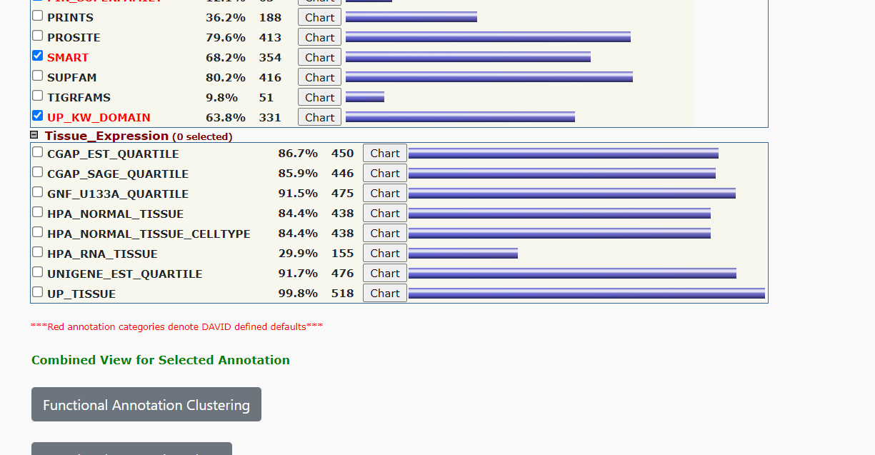

Slide 39
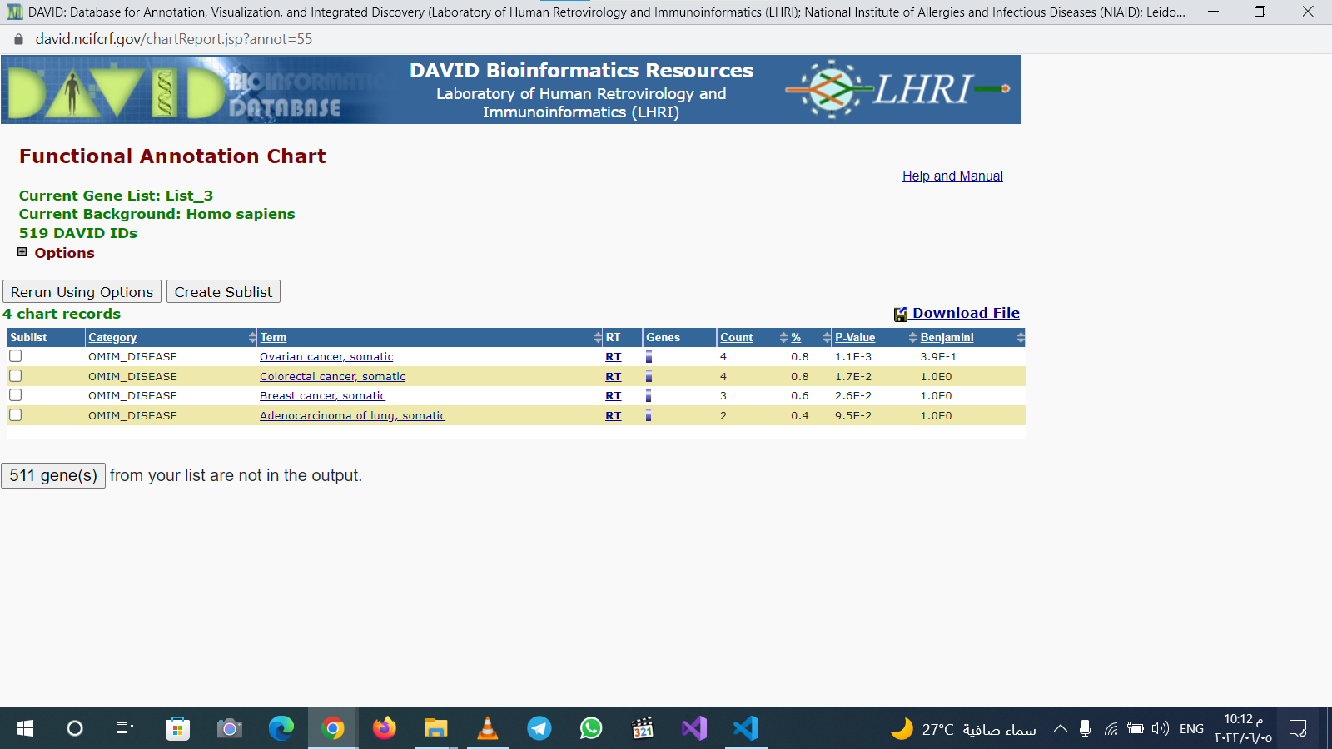

Slide 40
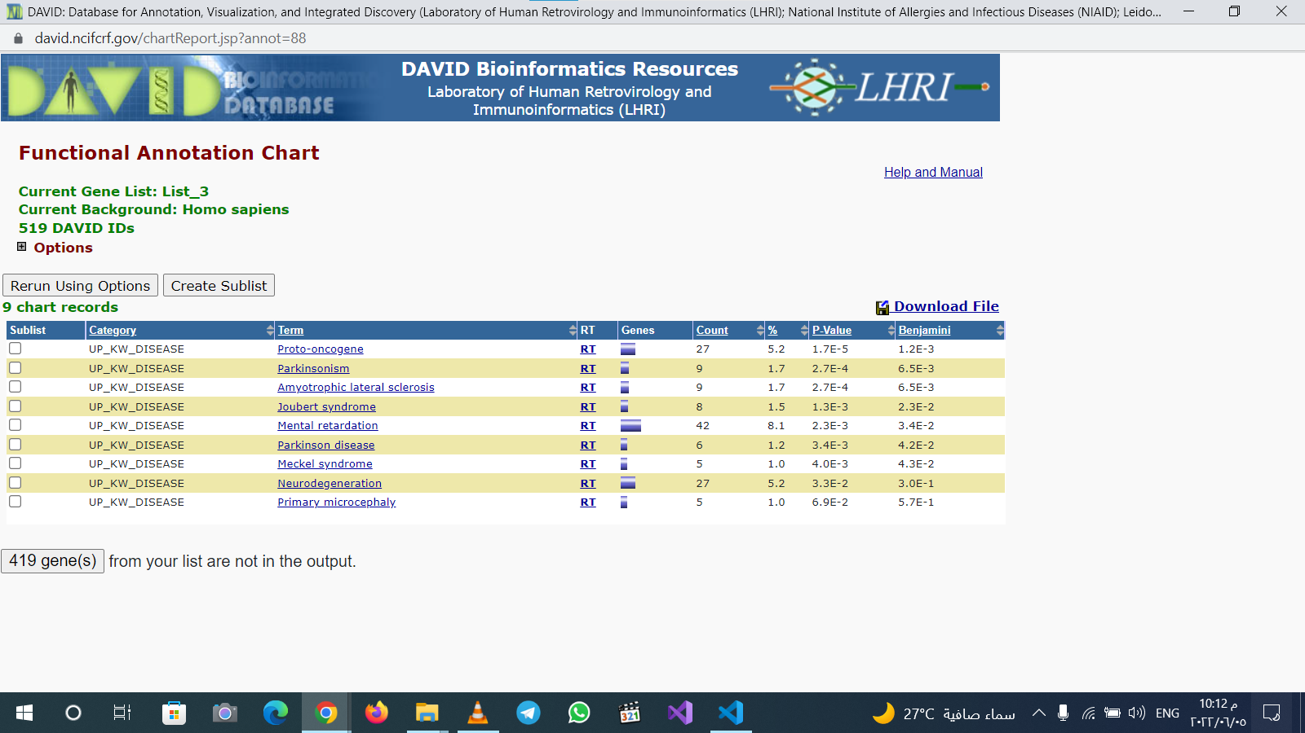

Slide 41
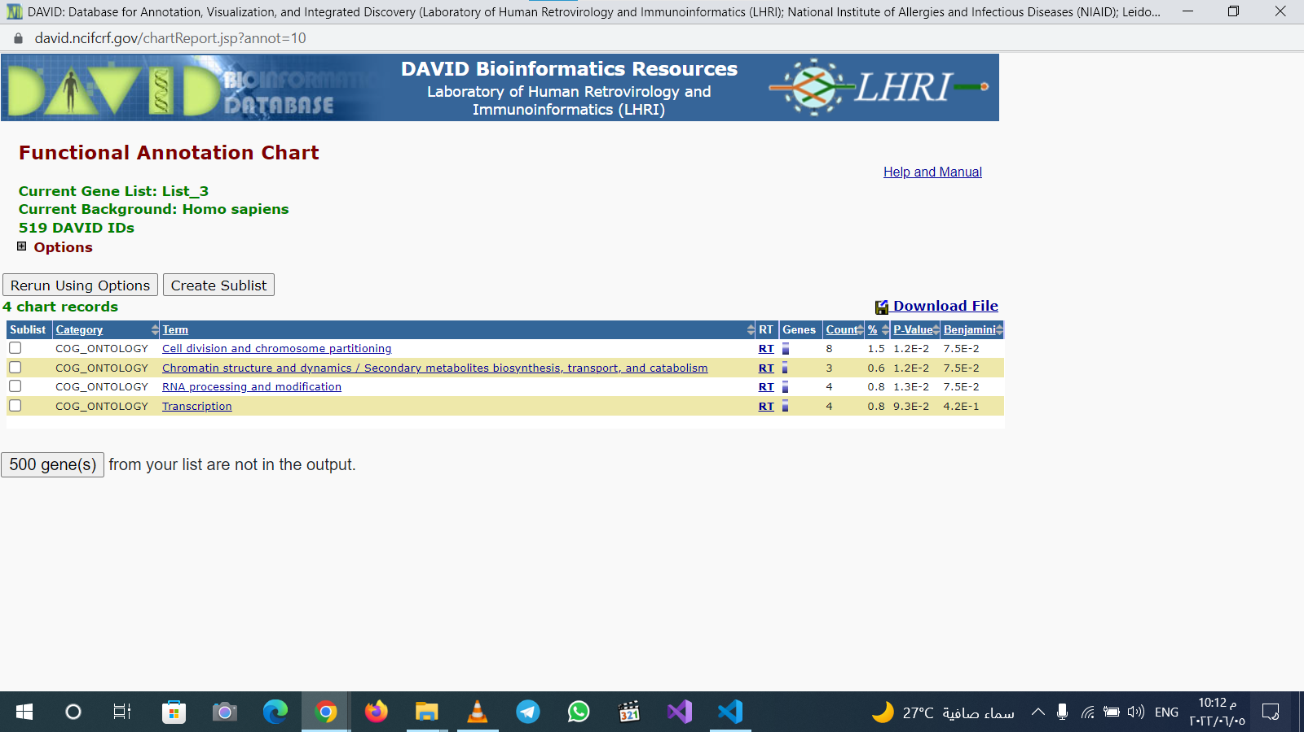

Slide 42
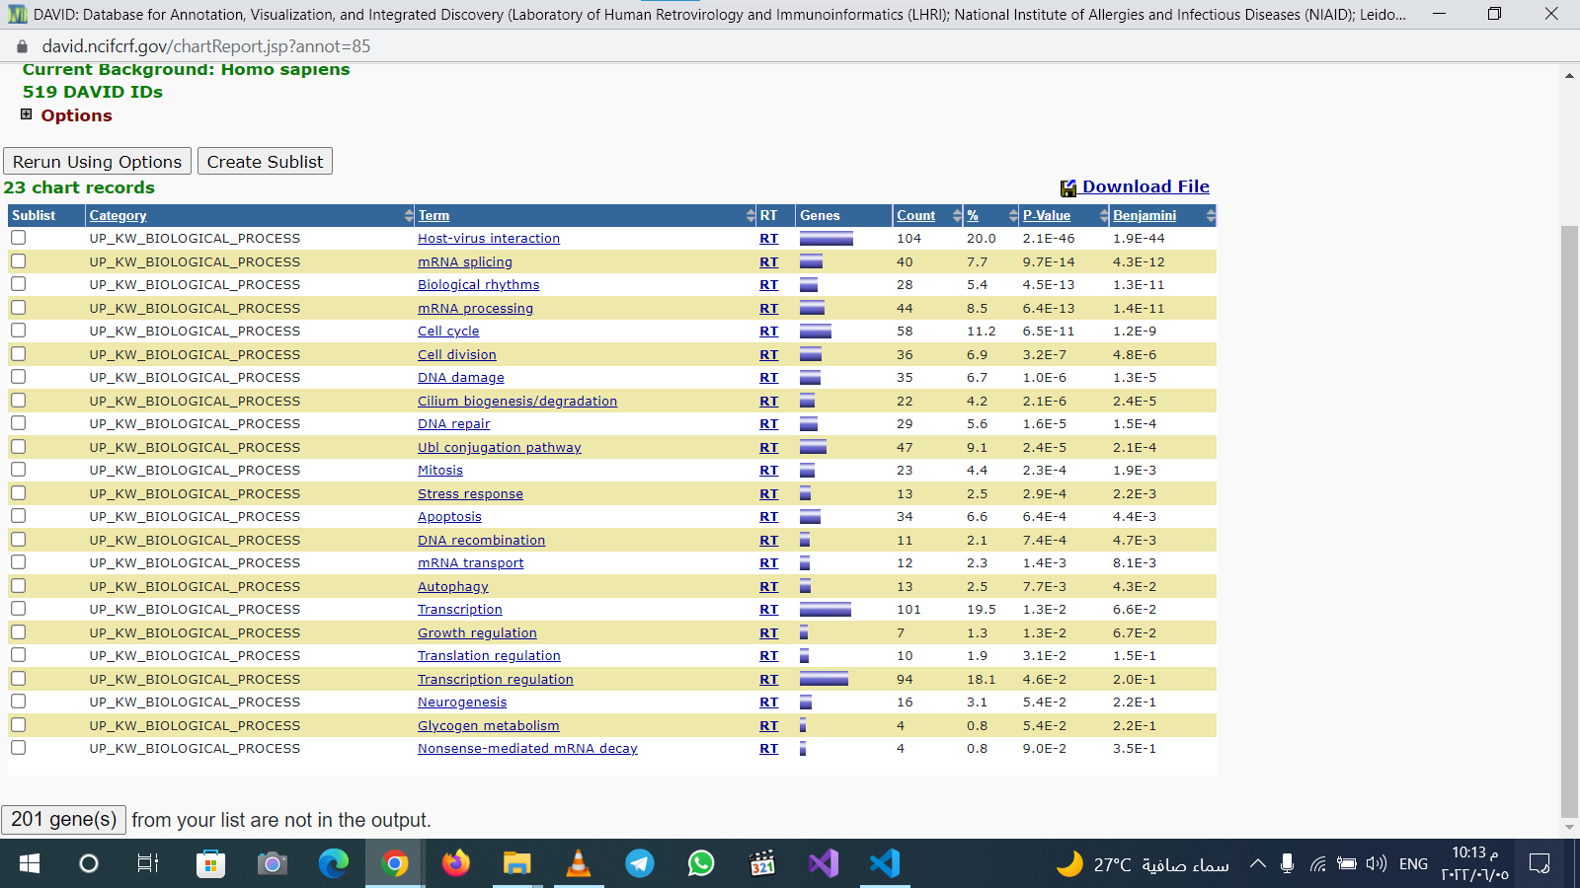

Slide 43
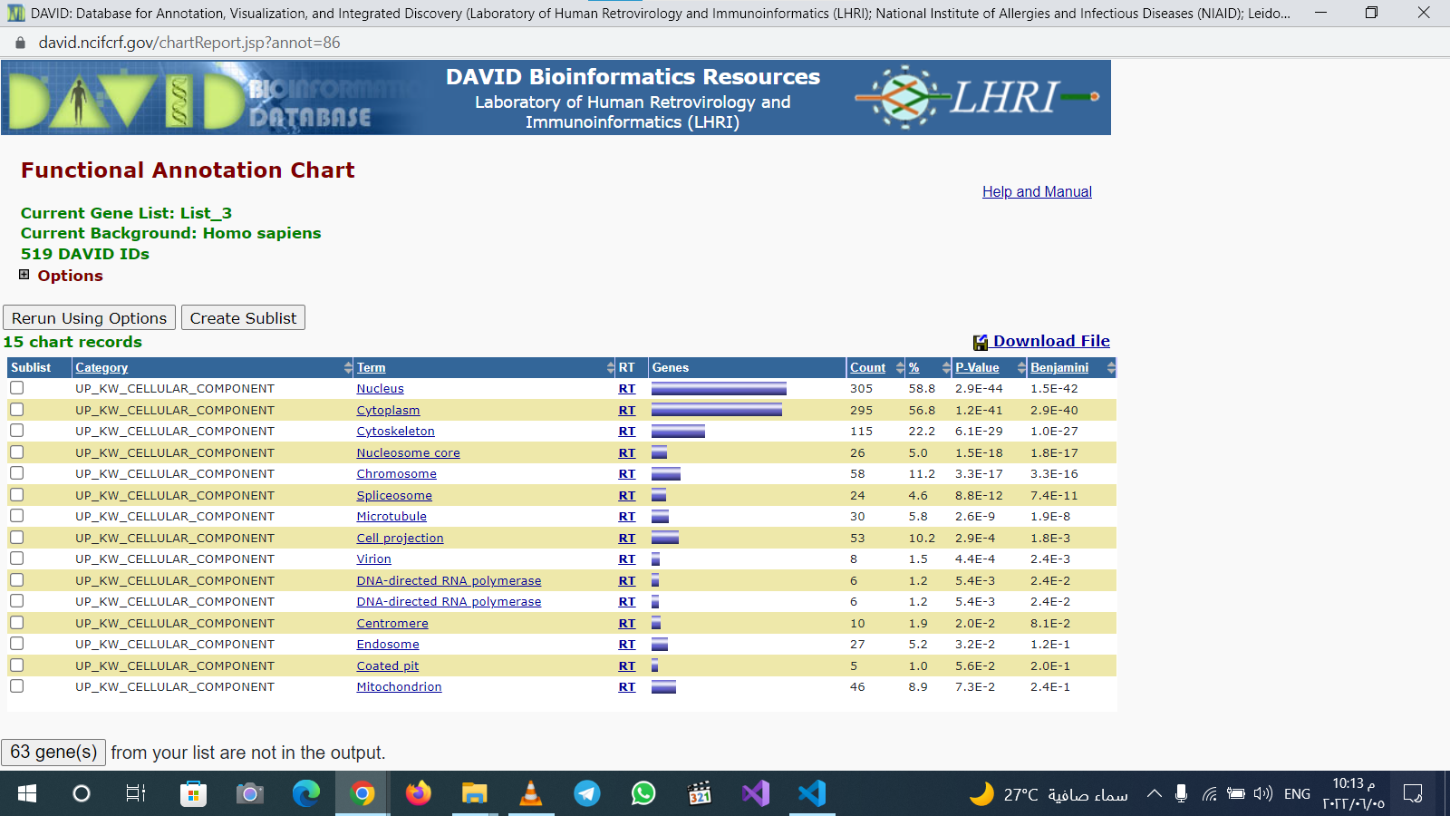

Slide 44
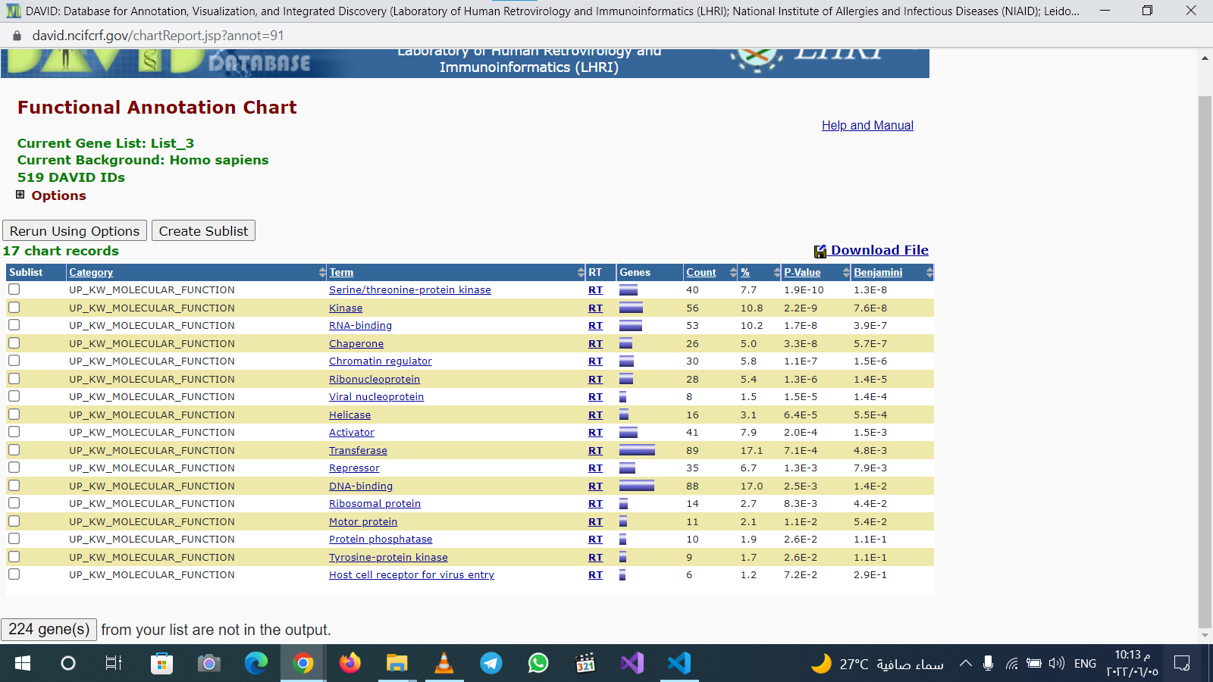

Slide 45
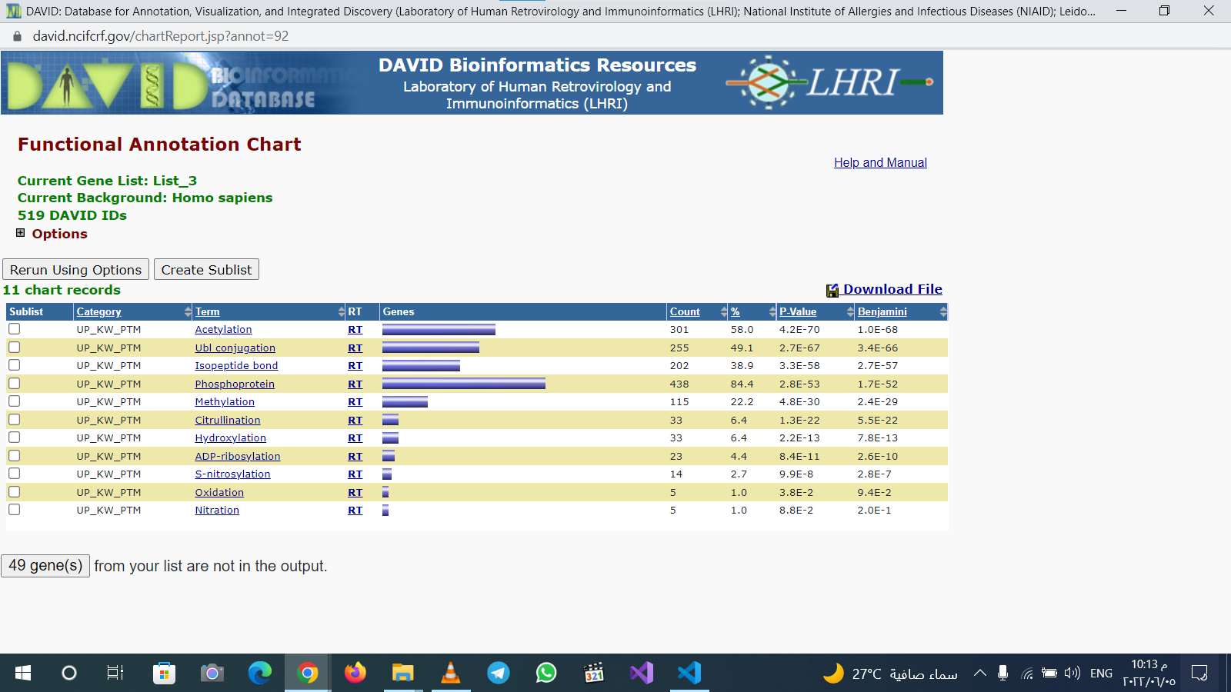

Slide 46
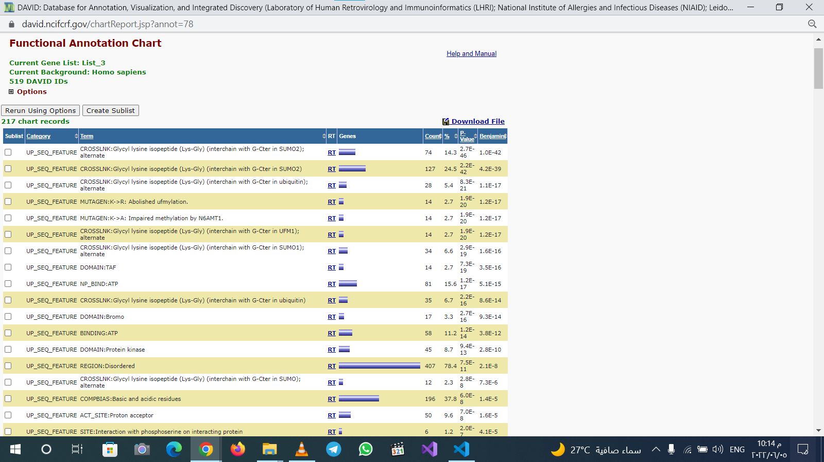

Slide 47
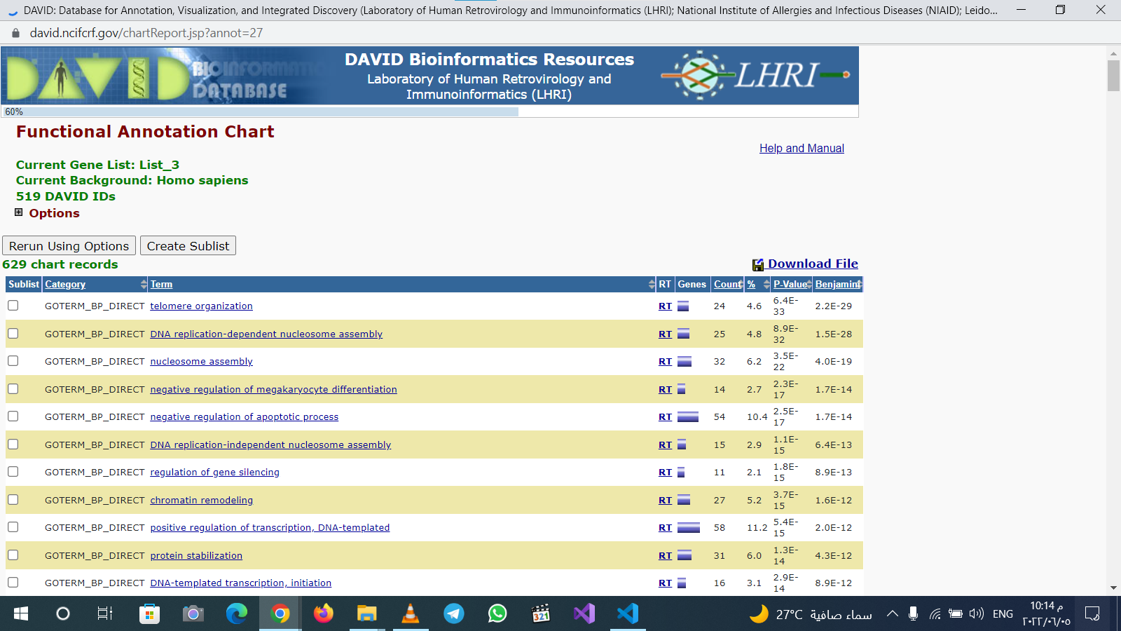

Slide 48
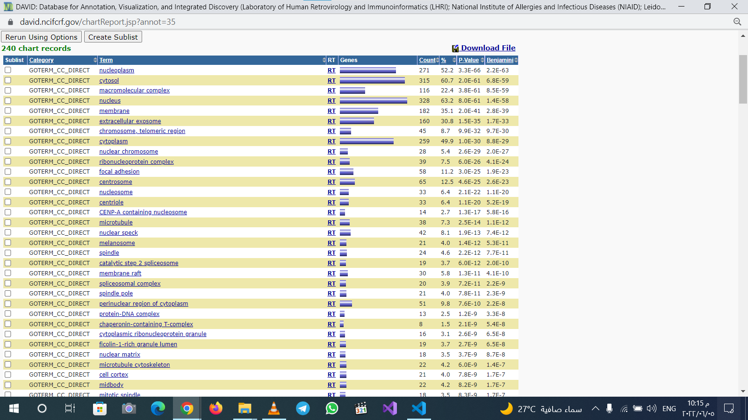

Slide 49
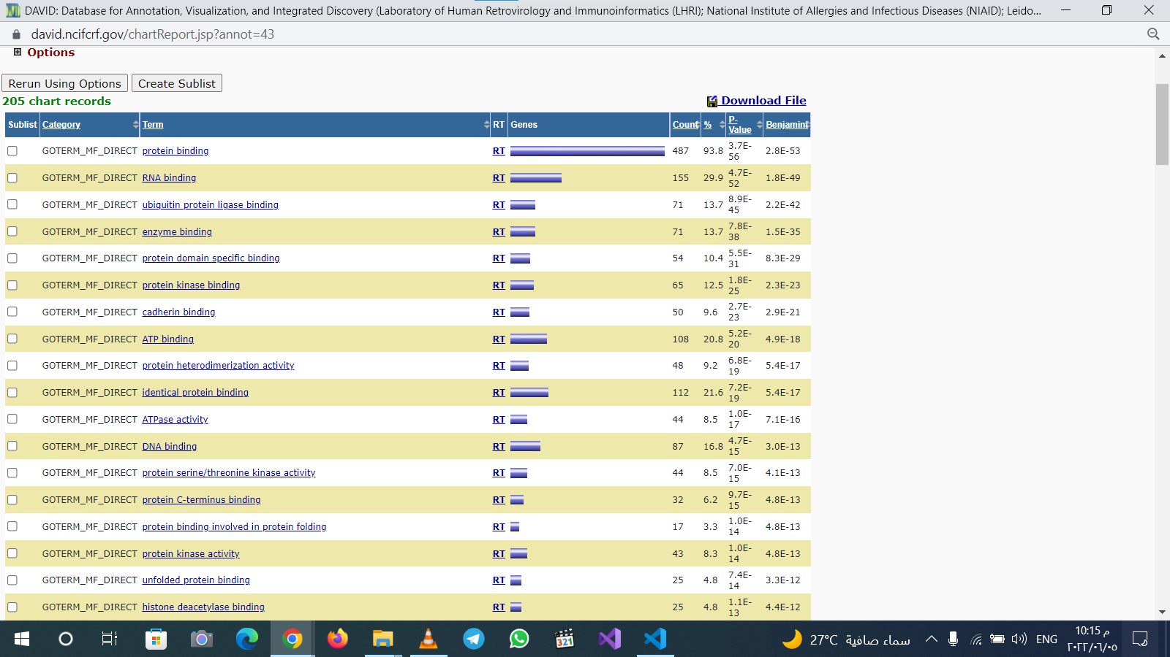

Slide 50
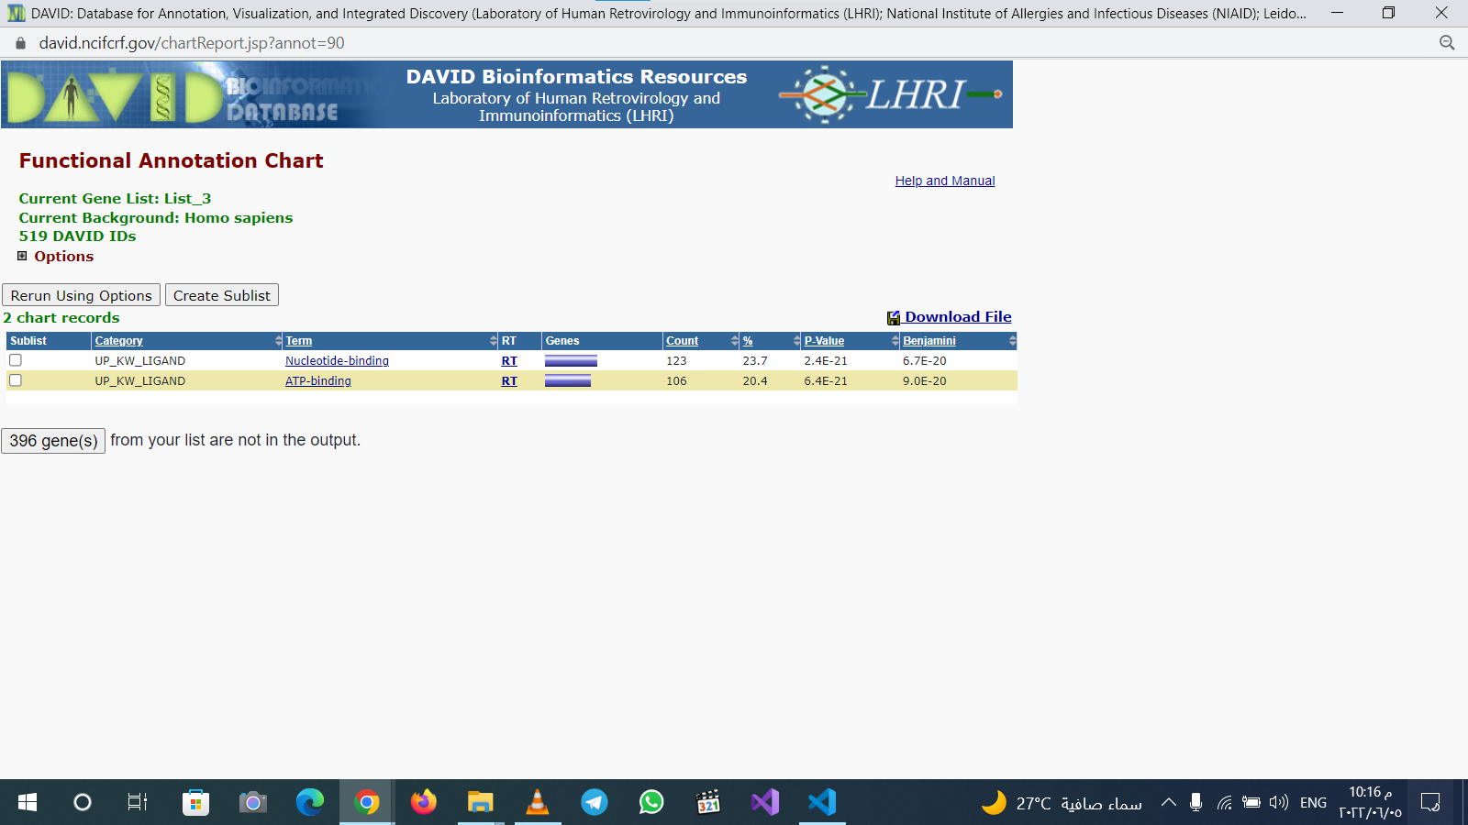

Slide 51
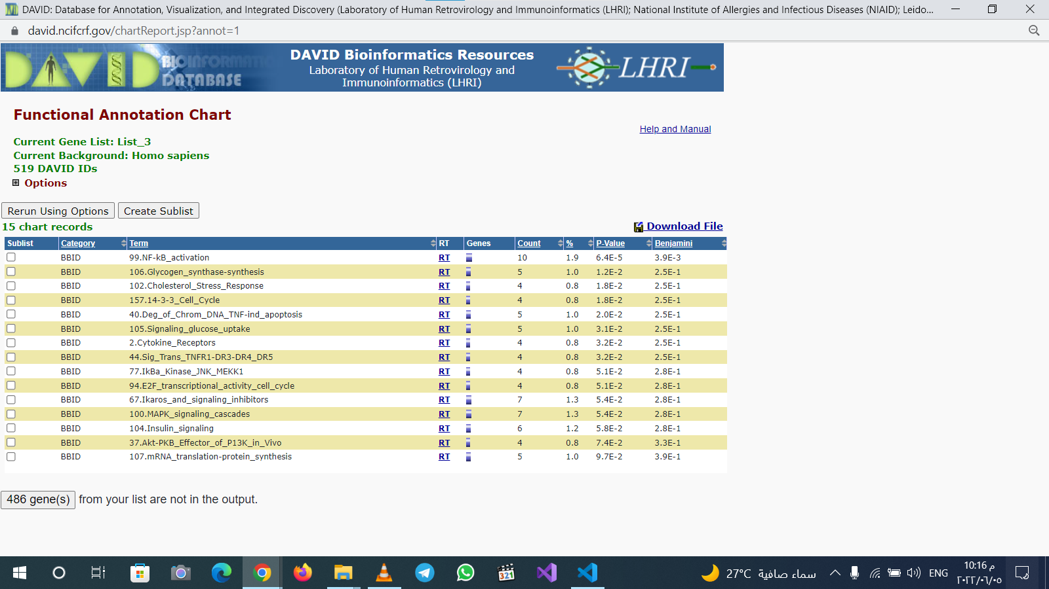

Slide 53
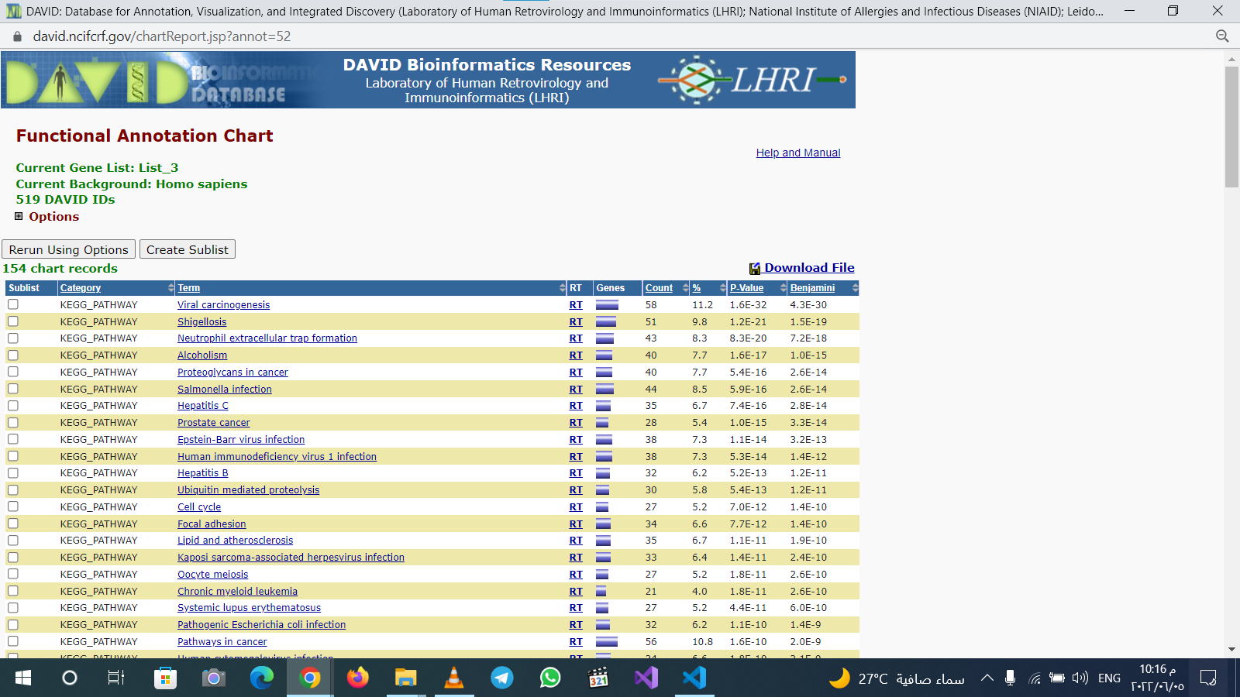

Slide 55
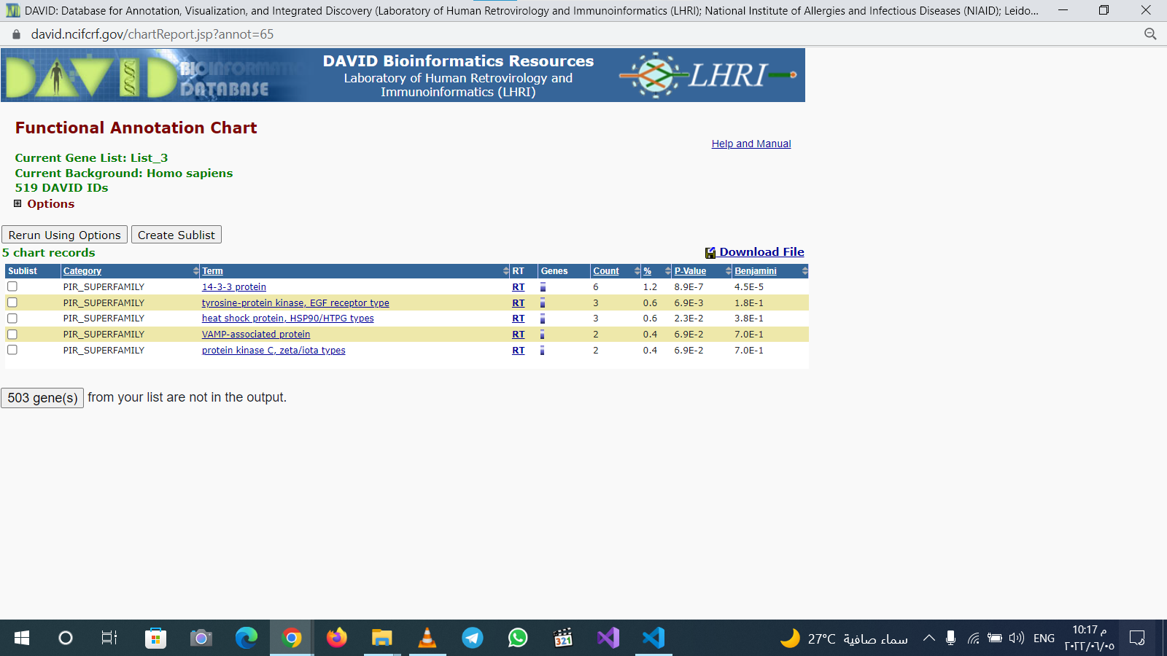

Slide 56
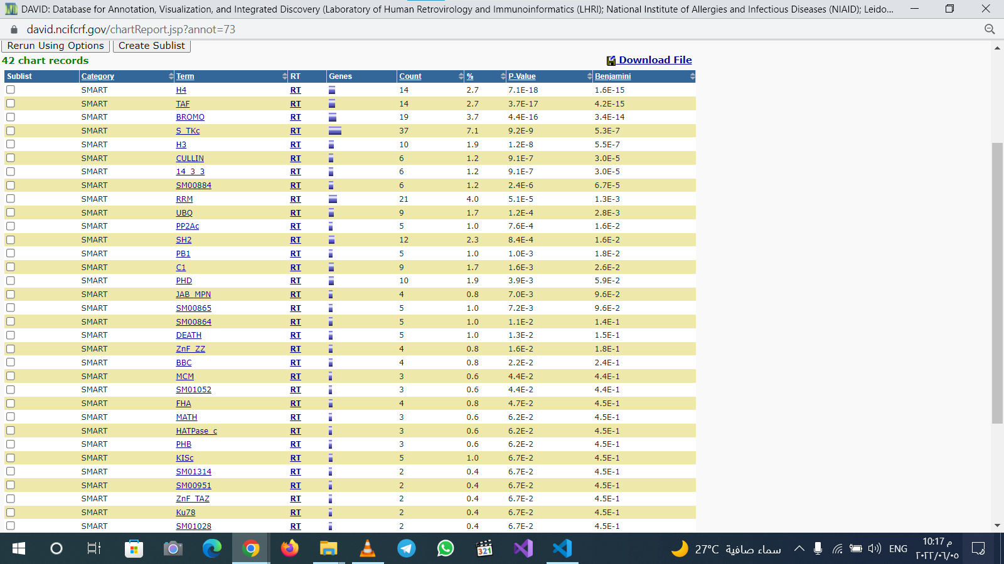

Slide 57
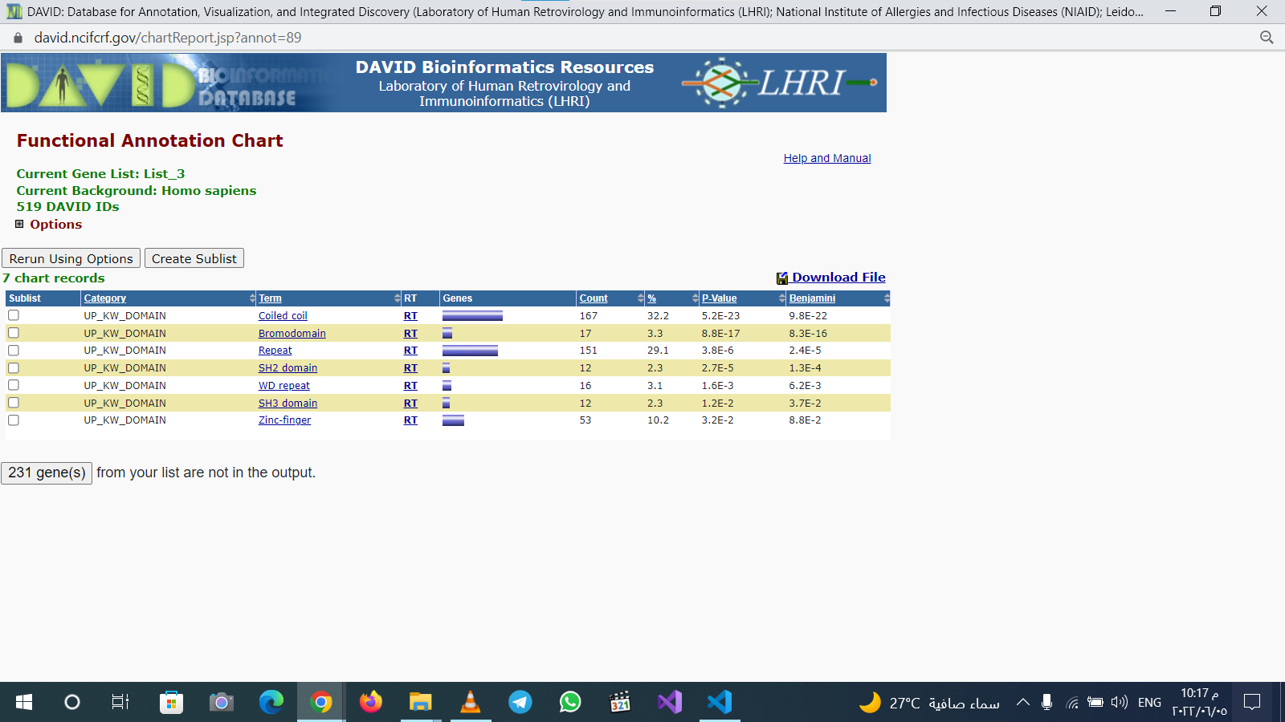

Slide 58
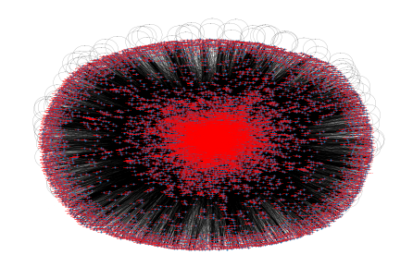
network

Slide 59
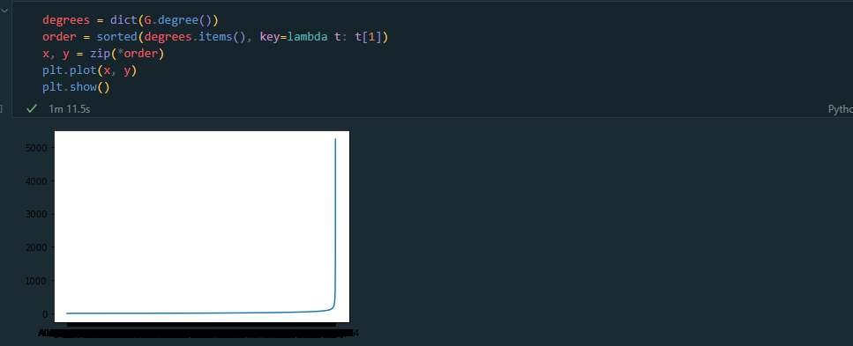
Degree plot

Slide 60

Degree sequence and counts

Slide 61

Degree distribution

Slide 62
P(K) & K plot

Slide 63


Slide 64


Slide 65

Saccharomyces Cerevisia David tools results

Slide 66


Slide 67


Slide 68


Slide 69


Slide 70


Slide 71


Slide 72


Slide 73


Slide 74


Slide 75


Slide 76


Slide 77


Slide 78


Slide 79


Slide 80


Slide 81


Slide 82


Slide 83


Slide 84

netwrok

Slide 85


Slide 86


Slide 87


